Slide 1
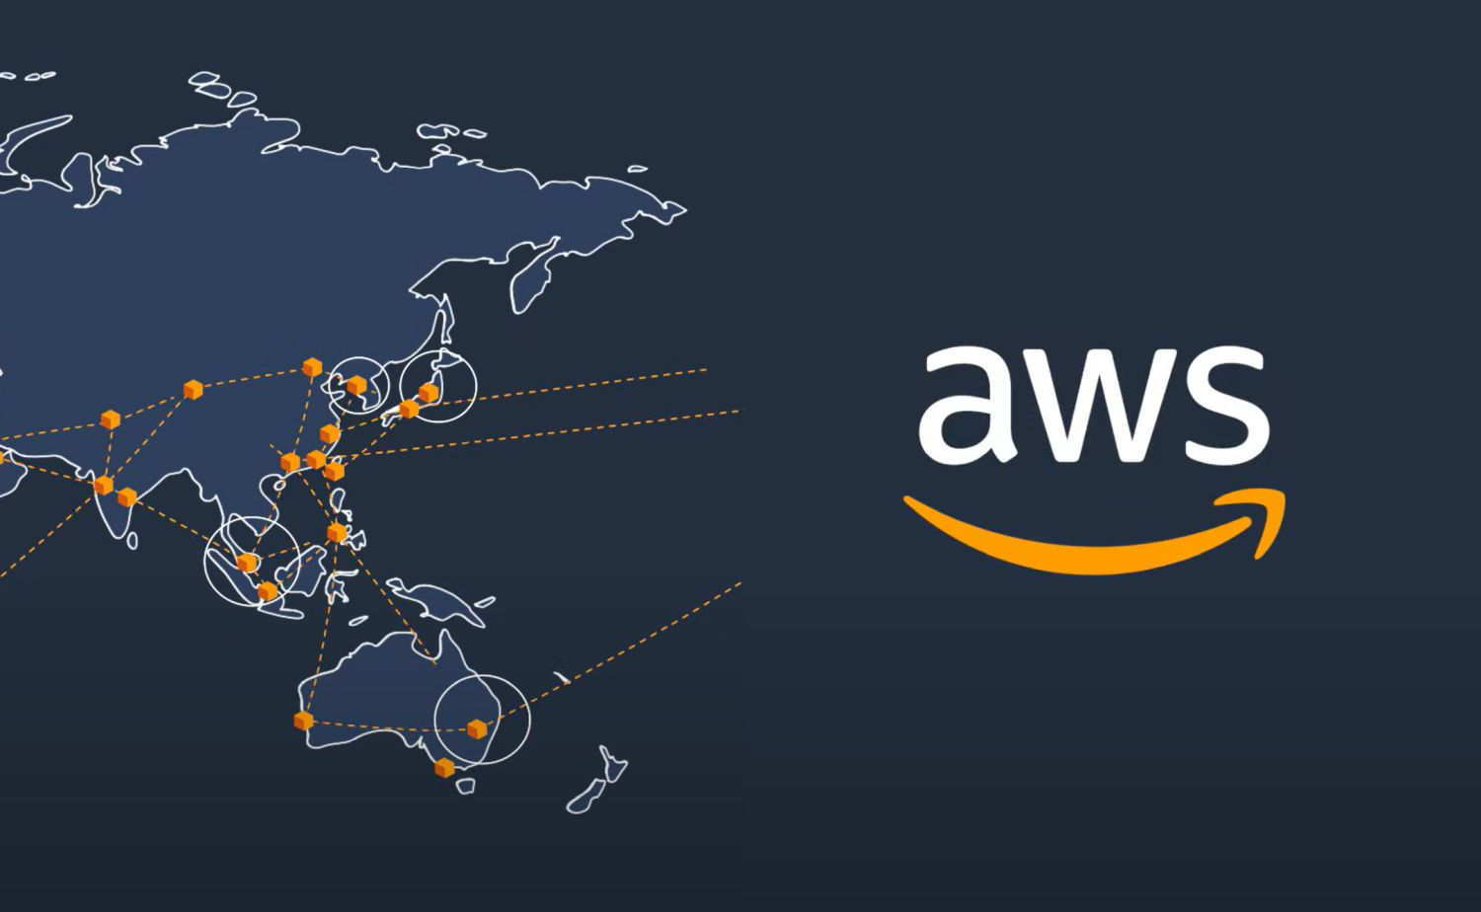
Overview of AWS CloudWatch

Slide 2
What is AWS CloudWatch?
A comprehensive monitoring and observability service from AWS.
Primary Functions:
Collects metrics and logs from AWS resources and on-premises servers.
Allows real-time monitoring and historical data analysis.
Integrates with AWS services for automated responses to system changes.
Purpose:
Ensures the health and performance of your applications and infrastructure.
Provides visibility into operational health, enabling proactive maintenance and troubleshooting.

Slide 3
Key Features of AWS CloudWatch
Metrics Collection
Granular Monitoring: Collect data at one-minute intervals (standard) or even one-second intervals for detailed insights.
Built-in Metrics: CPU utilization, memory usage, disk I/O, and network traffic are automatically tracked for AWS resources.
Custom Metrics: Users can send their own application-specific metrics to CloudWatch.
Logs Monitoring
Centralized Log Management: Aggregate logs from multiple AWS services like EC2, RDS, Lambda, and more.
Real-Time Monitoring: Monitor log streams in real-time, set up filters, and search for specific events or patterns.
Log Retention: Define how long logs should be retained, enabling long-term storage for compliance and analysis.

Slide 4
Alarms
Threshold-Based Alerts: Set specific thresholds for metrics and receive alerts when these thresholds are crossed.
Automated Actions: Trigger AWS Lambda functions, start/stop EC2 instances, or scale out/in based on alarm states.
Notifications: Integrate with Amazon SNS (Simple Notification Service) to send email, SMS, or push notifications.
Dashboards
Customizable Views: Build dashboards to visualize key metrics and logs in one place.
Multi-Account Support: View data across multiple AWS accounts and regions.
Sharing and Collaboration: Share dashboards with team members or embed them into third-party tools.

Slide 5
How AWS CloudWatch Works
Data Sources
AWS Services: EC2, RDS, Lambda, S3, and many more provide built-in metrics automatically.
Custom Applications: Applications can publish custom metrics and logs to CloudWatch via the AWS SDKs or CloudWatch Agent.
Data Collection
Metrics Collection: Automatically collected at predefined intervals, can be customized for higher granularity.
Log Collection: AWS CloudWatch Logs Agent can be installed on servers to forward log files to CloudWatch Logs.

Slide 6
Data Analysis
Metric Analysis: Use CloudWatch metrics to monitor trends, create alarms, and perform predictive analysis.
Log Analysis: Use CloudWatch Logs Insights to query and analyze log data, filter based on conditions, and identify issues.
Data Retention
Metrics: Stored in CloudWatch for up to 15 months, enabling long-term trend analysis.
Logs: Log retention policies can be customized, with options to archive logs to S3 for long-term storage.

Slide 7
CloudWatch Logs
Log Streams
Definition: A continuous flow of log events from a source, organized chronologically.
Real-Time Analysis: Monitor log streams in real-time to detect and react to issues as they occur.
Log Groups
Organizing Logs: Log events are organized into log groups, allowing for logical grouping by application, service, or environment.
Retention Settings: Define how long logs should be retained in each log group, from 1 day to indefinite.

Slide 8
Log Insights
Powerful Query Engine: Use a SQL-like query language to filter and analyze log data.
Pre-Built Queries: CloudWatch offers sample queries to get started with common tasks, such as identifying error trends or slow responses.
Visualization: Generate visual representations of log query results directly within the CloudWatch console.

Slide 9
Setting Up CloudWatch Alarms
Thresholds and Conditions
Define Metric Thresholds: Set specific numeric thresholds for metrics, such as CPU utilization > 80%.
Evaluation Periods: Specify how many consecutive periods the condition must be met to trigger the alarm.
Actions
Automated Scaling: Automatically scale up or down based on predefined conditions to handle traffic spikes or save costs.
EC2 Actions: Automatically reboot, stop, or terminate EC2 instances when alarms trigger.

Slide 10
State Changes
ALARM State: When a metric breaches the defined threshold.
OK State: When a metric returns to normal after being in the ALARM state.
INSUFFICIENT_DATA State: When data isn’t available for the metric.

Slide 11
Best Practices for AWS CloudWatch
Tagging and Organizing Resources
Use Tags: Organize resources by environment, application, or team for easier monitoring.
Tag-Based Filters: Filter metrics and logs by tags for focused analysis.
Custom Metrics
Define What Matters: Create custom metrics that reflect the most important performance indicators for your specific applications.
Granular Data Collection: Implement fine-grained monitoring where necessary, especially for critical components.

Slide 12
Regular Review of Alarms
Audit Alarms Periodically: Regularly review and update alarm thresholds to reflect current performance baselines.
Avoid Alarm Fatigue: Ensure alarms are meaningful to prevent desensitization.
Use of Dashboards
Centralize Monitoring: Build comprehensive dashboards that cover all critical aspects of your environment.
Automated Dashboard Updates: Use API or CloudFormation templates to automate the creation and updating of dashboards.

